Slide 1

Telecom Customer Churn Analysis
Using Power BI
Rakesh Punati
Batch No: 403
Dilsukhnagar

Slide 2

Agenda
Project Overview Data Source Data Preparation
Dashboard Visualizations Applications & Recommendations Conclusion
Any Queries

Slide 3
Project Overview
To analyze customer churn patterns and identify the key factors influencing customer attrition. To understand customer behavior based on demographics, service subscriptions, and billing information.
To measure churn rate across various customer segments such as contract type, internet service, and payment method.
To visualize business performance using interactive Power BI dashboards and KPIs.
To predict churn risk and highlight high-risk customer segments for targeted retention strategies.
To support data-driven decisions that can reduce churn, increase customer satisfaction,
and improve revenue stability.

Slide 4
Data Source
Dataset Name: Telco Customer Churn Dataset
File Type: Excel file
Total Records: 7,043 customers Total Columns: 21 fields

Slide 5
Data Preparation
Imported dataset into Power BI Desktop from Excel file.
Performed data cleaning using Power Query Editor to ensure accuracy and consistency.
Checked and removed null values in columns like TotalCharges and replaced blanks where necessary. Converted TotalCharges from text to numeric.
Ensured SeniorCitizen, Churn, and Partner were properly categorized as Yes/No or binary fields. Created calculated columns and DAX measures for:
Churn Rate, Average Monthly Charges, Average Tenure, Total Revenue Standardized categorical values ( No internet service changed to No for clarity). Added new derived fields for advanced analysis such as:
Total Services Subscribed (count of services per customer) Validated the dataset to ensure no duplicates or mismatched entries.
Loaded the cleaned data into the Power BI Model for visualization and analysis.

Slide 6
Dashboard Visualizations
1. Customer Demographics Dashboard
Visuals Used:
Donut Chart → Gender distribution
Bar Chart → Senior citizen vs. non-senior churn comparison Column Chart → Tenure segmentation
Line Chart → Churn rate across tenure groups
Cards → Total Customers, Churned Customers, Churn Rate, Avg. Tenure, Avg. Monthly Charges Purpose: Understand customer profile and churn behavior by demographics.

Slide 7
Dashboard Visualizations
2. Service Subscription Dashboard
Visuals Used:
Stacked Column Chart → Phone service and internet service usage
Funnel Chart → Churn rate by Internet Service Type (DSL, Fiber Optic, No Internet) Clustered Bar Chart → Add-on service usage by churned customers
Scatter Plot → Correlation between number of services and churn Pie Chart → Fiber vs. DSL vs. No Internet customers
Slicers → Gender, Senior Citizen, Internet Service, Contract Type Purpose: Identify which services and combinations impact churn the most.

Slide 8
Dashboard Visualizations
3. Contract & Billing Dashboard
Visuals Used:
Bar Chart → Churn by Contract Type (Month-to-month, One year, Two year) Donut Chart → Payment Method distribution
Clustered Column Chart → Avg. Total Charges by Contract Type Line Chart → Monthly Charges by Payment Method Matrix/Table → Billing KPIs by Contract Type
Cards → Avg. Monthly Charge, Avg. Total Charge, Churn Rate, Total Churned Customers Purpose: Analyze billing behavior and contractual patterns influencing churn.

Slide 9
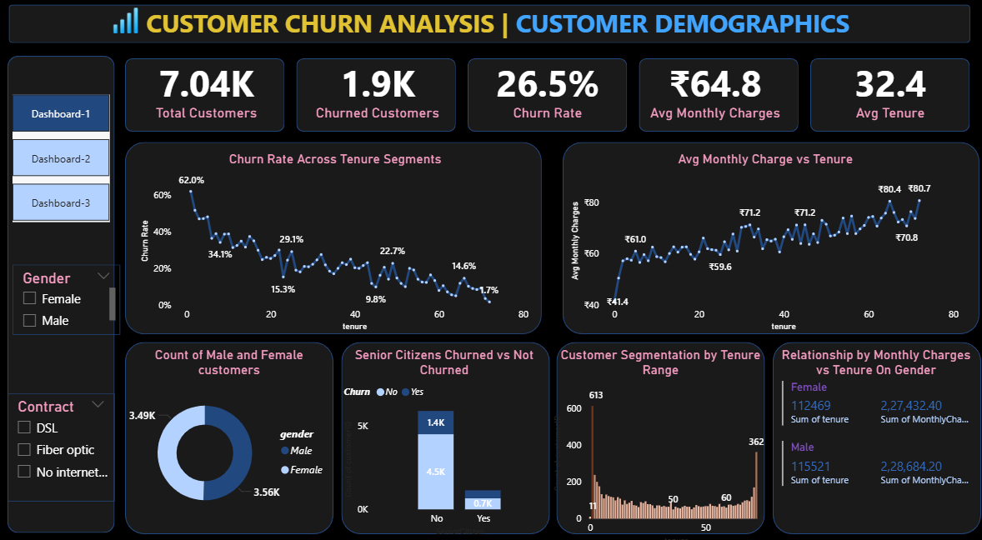

Slide 10
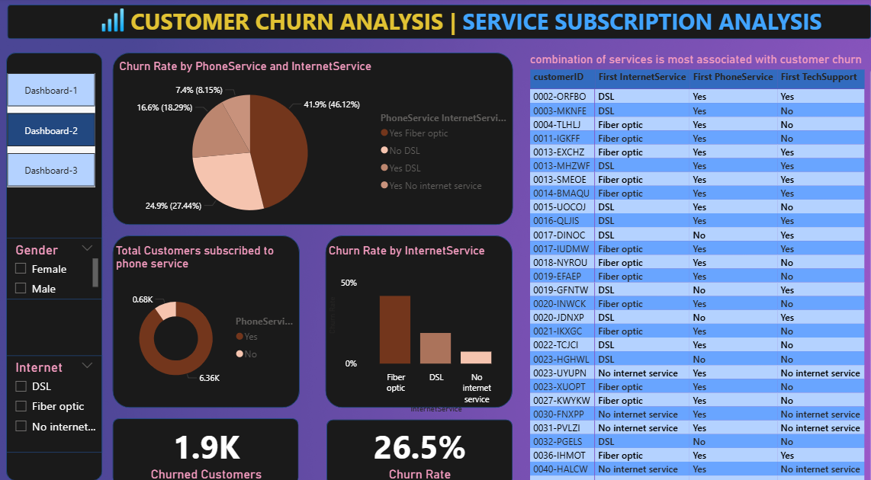

Slide 11
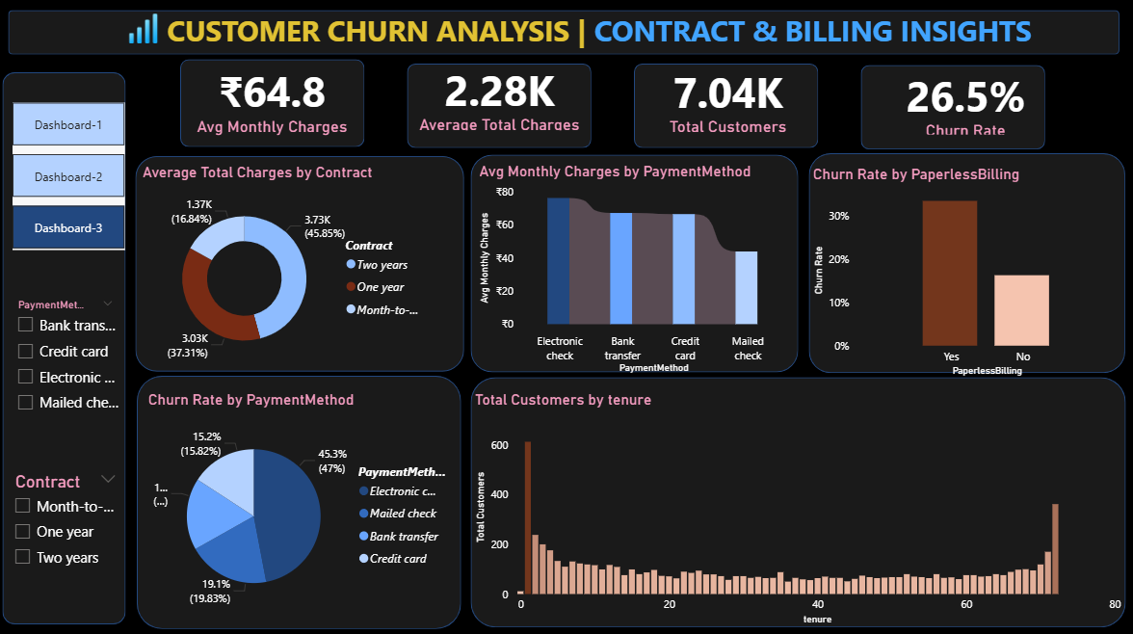

Slide 12
Applications & Recommendations
Applications
Used by Marketing Teams to identify and target high-risk customers with retention offers. Helps Customer Support prioritize service improvement for segments with high churn.
Enables Management to track key churn KPIs and make data-driven strategic decisions. Supports Product Teams in optimizing service bundles and pricing models.
Recommendations
Encourage long-term contracts (1-year or 2-year plans) through discounts and loyalty rewards. Promote bundled service packages (e.g., Internet + Streaming + Security) to reduce churn.
Improve customer retention by offering personalized plans for senior citizens and high-charge users. Educate customers about benefits of online backup and device protection services, as these reduce churn. Monitor monthly charges and payment issues closely for early churn indicators.

Slide 13
Conclusion
The Power BI dashboards provided clear visibility into customer churn behavior and patterns. Analysis revealed that high monthly charges, month-to-month contracts, and fiber optic services are major churn drivers.
Customers with longer tenure and multiple service subscriptions show greater loyalty and lower churn. Demographic factors such as senior citizen status and partner/dependent presence also influence churn tendency.
The insights enable the company to design targeted retention strategies and reduce customer loss. Implementing data-driven actions can help boost customer satisfaction, increase retention rate, and maximize revenue.
Overall, the project demonstrates how Power BI transforms raw data into actionable business insights for strategic decision-making.

Slide 14

ANY
Queries?

Slide 15

THANK YOU

